Slide 1
GozWhit
Software Engineering Project
Smart and Secure Helmet
By Marla Akhil Reddy(13BCE1078) and Chava Sai Teja(13BCE1032)

Slide 2
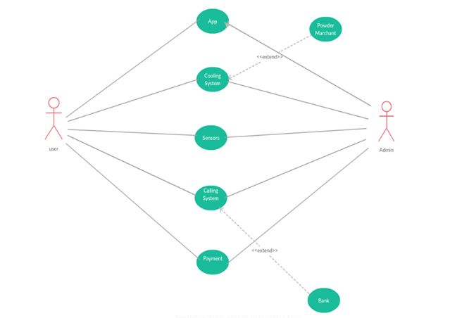
Main Use Case Diagram

Slide 3
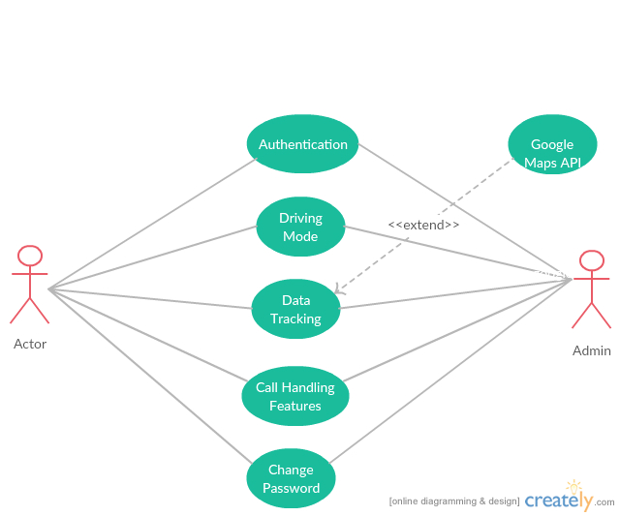
APP Use Case Diagram

Slide 4
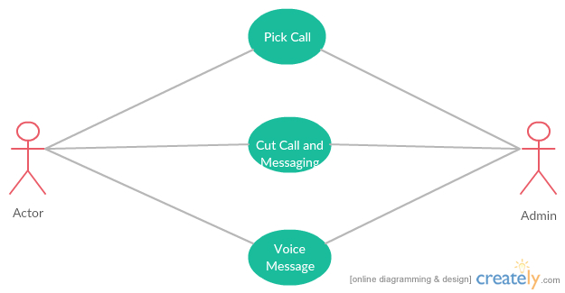
Calling System Use Case Diagram

Slide 5
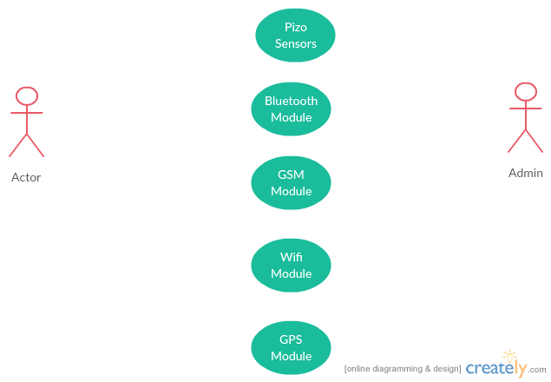
Sensors Use Case Diagram

Slide 6
S.NO | USE CASE | Actors | Pre and Post Conditions | Modular Description
1 | App | Customer, Seller | Registration | What options will be provided in app.Authentication and validation of user
2. | Cooling System | Customer, Chemical Merchant | Chemical Avalability | Maintains the temperature inside the helmet.
3. | Sensors | User,Admin | Power,Internet | To give real time information of pressure, temprature,speed etc.
4. | Calling System | User, Dailer | Connection to Mobile Operator via Phone | Accept calls, Reject by sending appropriate messages, Automatic voice response
5. | Payment | User,Bank | Registered User | Mode of payment, different packs he can recharge with.

Slide 7
THanK YoU

